Slide 1
System Architecture
System Servers
Container n
Container n
Load Balancer
Container
Container n
Container n
DB Container
WebServer
Containers
User Containers
Container Manager (LXD)
Linux OS
Host Machine

Slide 2
System Functionality
Client HTTP Request
Host Machine
Load Balancer
Web Server
DB
Host Machine forwards the request to the Load Balancer
Load Balancer directs the request to the appropriate Web Server
Web Server pulls the information from de DB

Slide 3
Script Functionality
Check LoadBalancer
Load OK
Yes
No
LXD creates new WebServer Container

Slide 4
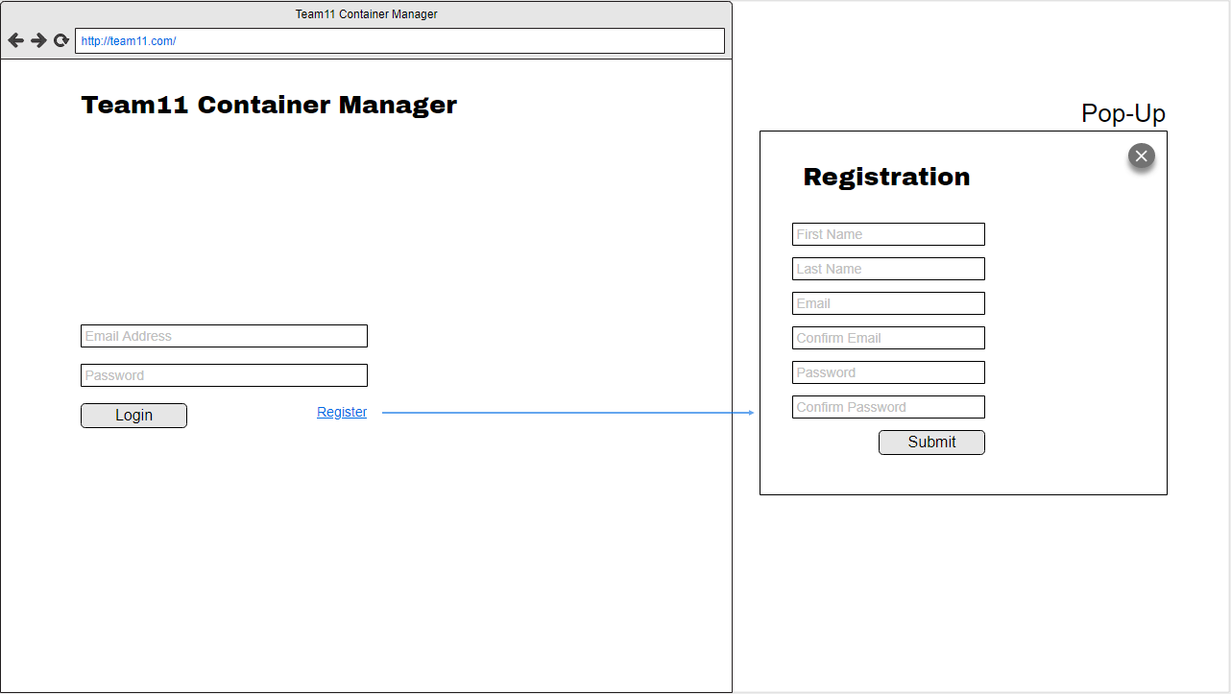
Mockups – Login Page

Slide 5
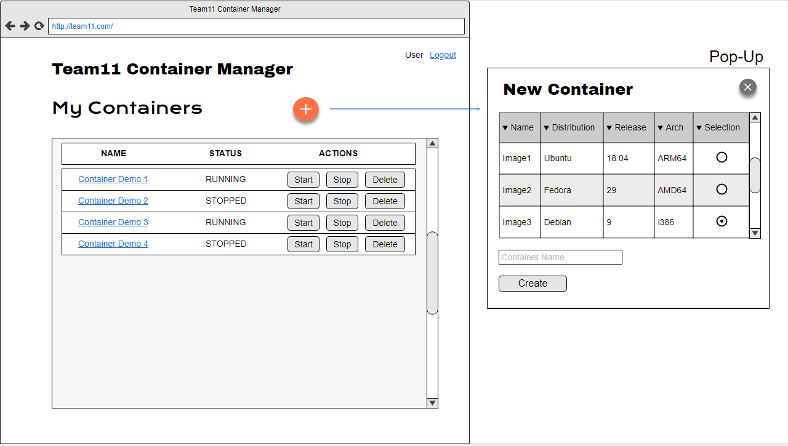
Mockups – Main Page

Slide 6
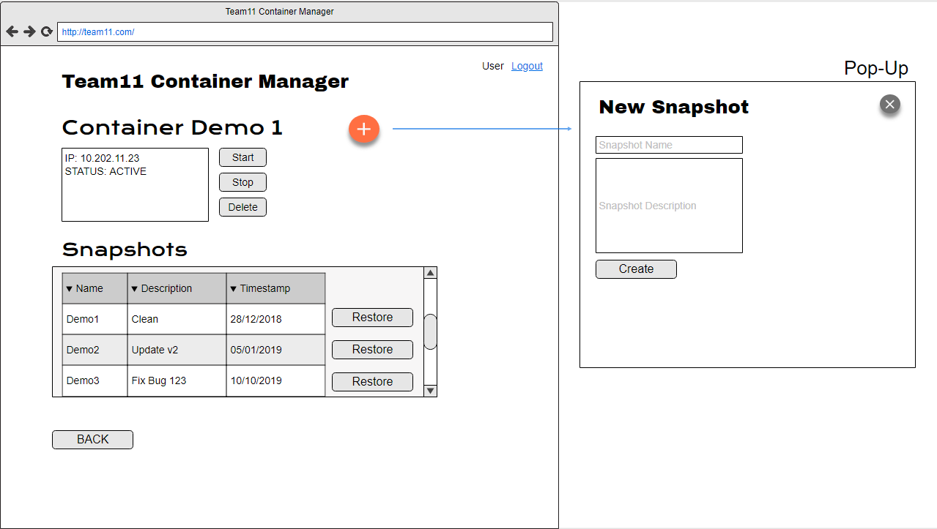
Mockups – Container Details Page

Slide 7
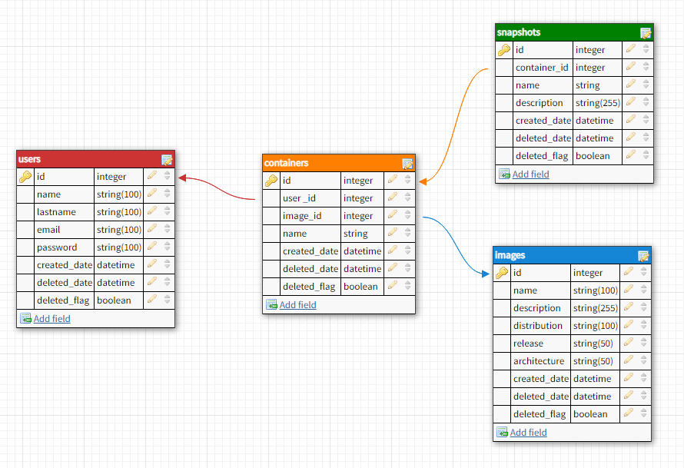
Database Design

